Slide 1

Android Tutorial
CSC 4320/6320

Slide 2
Overview
Introduction of Android App Development.
What is Android?
Android Architecture
Basic Modules/Components
Configure development Environment
How to install Android Studio?
Environment setup in Android Studio.
File Structure
Demo 1: Develop a Hello World App.
Demo 2: A simple Process Manager App.

Slide 3

What is Android?
Android is the first truly open and comprehensive platform for mobile devices. It includes an operating system, user-interface and applications -- all of the software to run a mobile phone, but without the proprietary obstacles that have hindered mobile innovation.
Referred from https://googleblog.blogspot.com/2007/11/wheres-my-gphone.html
3 main parts
Operating System for embedded device
Open-source development platform for application
The device which runs Android OS and the application for this OS

Slide 4
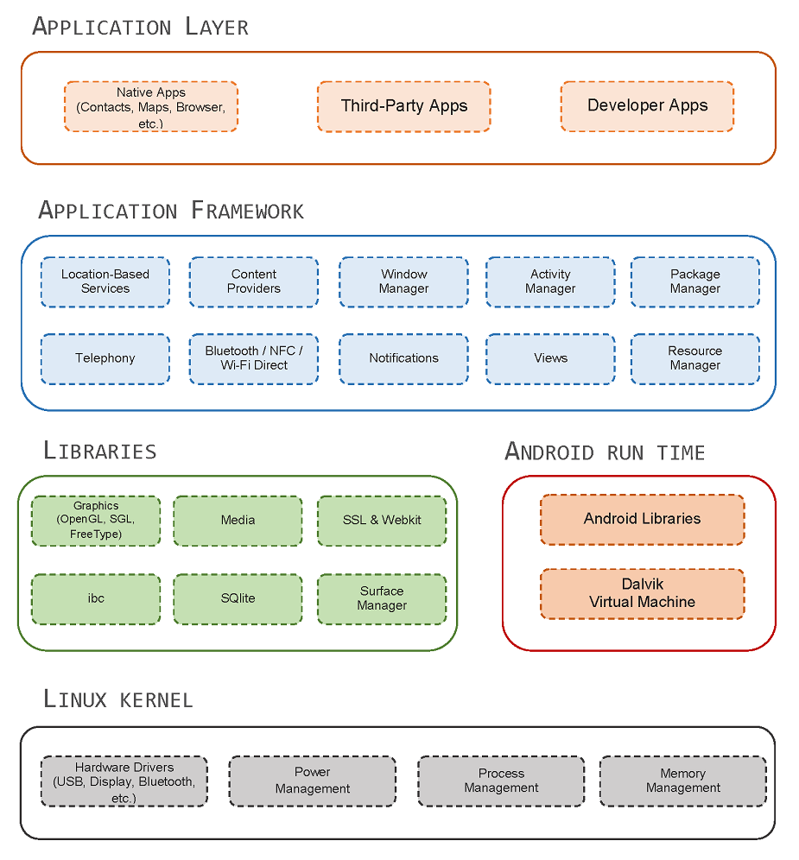
Android Architecture
Linux Kernel
Hardware Drivers
Process management
Memory management
Security management
Internet management
Power managements

Slide 5
Android Architecture
Libraries (C/C++ core libraries)
libc or SSL
Media
Appearance
SGL and OpenGL (2D/3D)
SQLite (DB)
WebKit (browser & SSL)

Slide 6
Android Architecture
Android Run Time
Android Libraries
Java core libraries
Android specific libraries
Dalvik Virtual Machine
Based on register of
Operating System
Depends on the
Linux kernel thread and
memory management
Kink of like a Java virtual
machine for Android

Slide 7
Android Architecture
Application Framework
Classes which for create
application
Abstract for access
hardware
User interface and
App source management

Slide 8
Android Architecture
Application Layer
Native application
Third-part application
Run in Android Run Time
Use the service from
Application Framework.

Slide 9
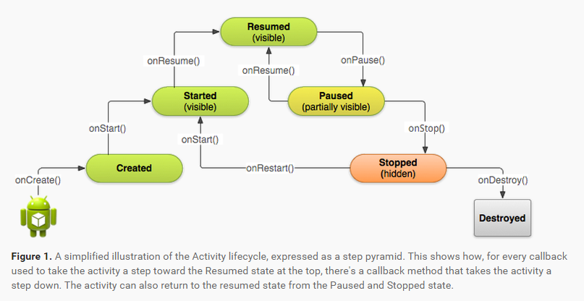
Managing Activity life cycle

Slide 10
Basic Modules
Activity
Presentation Lay of application. Each of UI in application
is implemented through Activity class or extension.
Using View and Fragment to layout and display information.
Service
Update data source, activity, trigger notification and
broadcast intent.
Background processing associated with an application.
Content Provider
Manage and persist data for application.
Understand like Hibernate or JDBC in web application.

Slide 11
Basic Modules
Intent
Framework communication between different application
by transfer message.
Startup or shutdown activity and service.
Broadcast Receiver
Intent listener, startup related application to response
the received intent.
Widget
Special broadcast receiver, for creating dynamic interacted
application component.
Notification

Slide 12
Environment Set up
Option 1 – Android Studio
Step 1: Set up Java SDK
Step 2: Android Studio
Option 2 – Eclipse with ADT
Step 1: Set up Java SDK
Step 2: Setup Android SDK
Step 3: Setup Eclipse IDE
Step 4: Setup Android Development Tools (ADT) Plugin

Slide 13
Environment Config - Option 1
JDK Installation
Download JDK
Search “JDK” in google, find the download page, or directly
click the link below http://www.oracle.com/technetwork/java/javase/downloads/jdk8-downloads-2133151.html
Check the “Accept License Agreement” to accept
download agreement
Choose the correct version of JDK for your PC’s
Operating System.
Ubuntu: Linux x86.tar.gz / Linux x64.tar.gz

Slide 14
Environment Config - Option 1
Install JDK
Ubuntu (Mac is similar):
Unzip file, and move it into “/usr/local/java/”
Create a Java environment variable ”JAVA_HOME”
Edit profile file in /etc/, and append the following sentences on
it.
#JAVA_HOME
Export JAVA_HOME=“/usr/local/java/jdk1.8.0_121”
Export JRE_HOME=“/usr/local/java/jre1.8.0_121”
Export PATH=“$PATH:$JAVA_HOME/bin:$JRE_HOME
/bin”
Execute profile file, “source /etc/profile”
Test java installation success or not
“java -version”

Slide 15
Environment Config - Option 1
Install JDK
Windows:
Execute jdk1.8.0_121.exe with default setting.
Right click “This PC” -> click properties
Click “Environment Variables…” in Advanced tab
In the System variables field, click “New” to create a new variable
Variable name :JAVA_HOME
Variable value: C:\Program Files\Java\jdk1.8.0_121
Find “CLASSPATH”, if no, create new one
Variable name: CLASSPATH
Variable value: %JAVA_HOME%\lib\dt.jar;%JAVA_HOME%\lib\
tools.jar;
Find “PATH”, if no, create new one; if there is, append it
Double click Path, and click “New” in pop window
Add “%JAVA_HOME%\bin” in it.

Slide 16
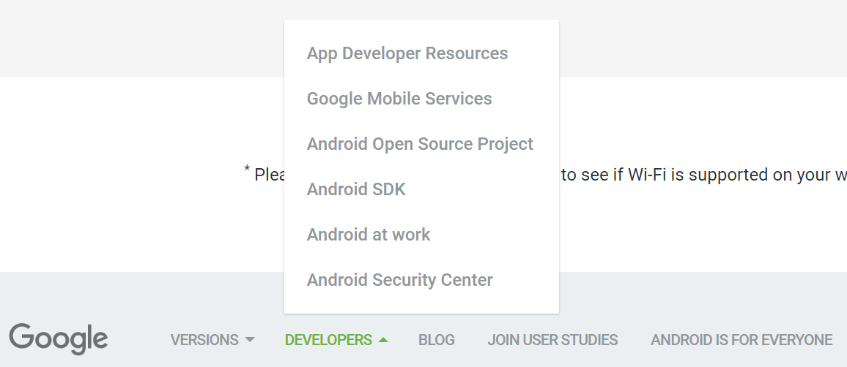
Android Studio
Android Studio Installation (Windows)
Download Android Studio
Go to www.android.com scroll down and click “Developers” -> “App Developer Resources”

Slide 17
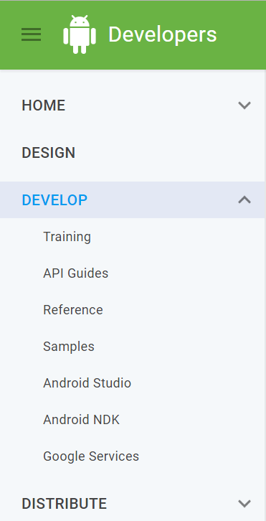
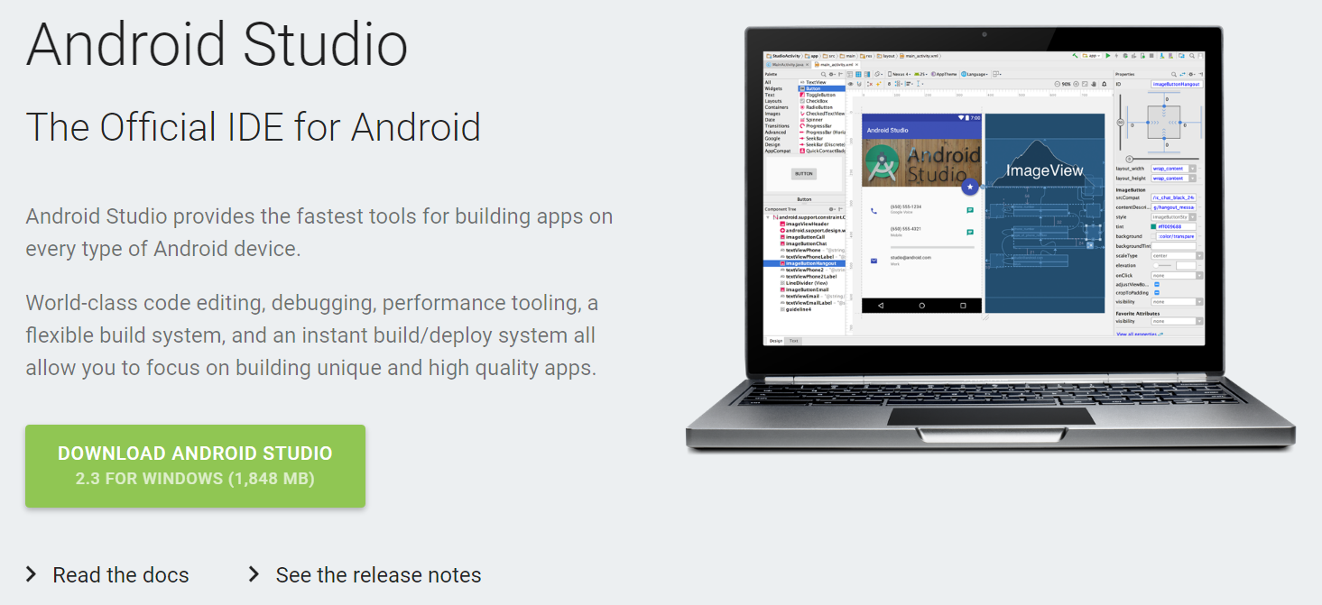
Android Studio
On the left menu, click “Android Studio”
Then click “Download Android Studio”

Slide 18
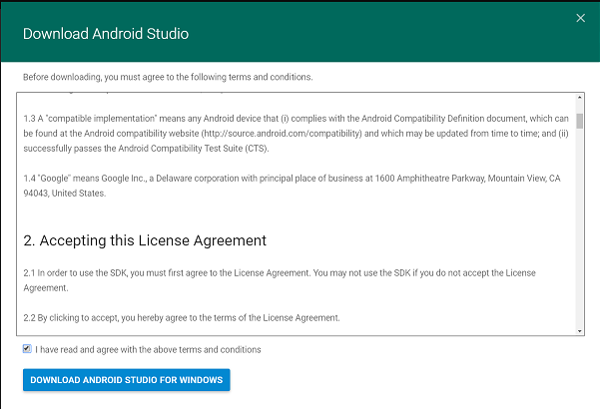
Android Studio
Check agree checkbox, and click “Download Android Studio for Window”.
You will be brined to a simple official installation video tutorial,
follow that to complete installation.

Slide 19
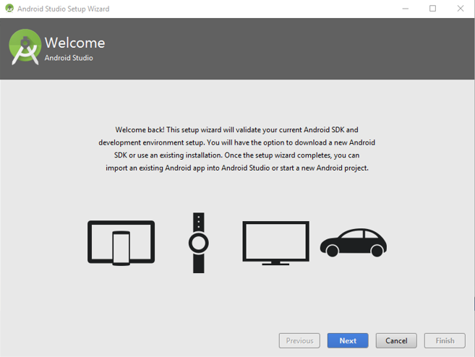
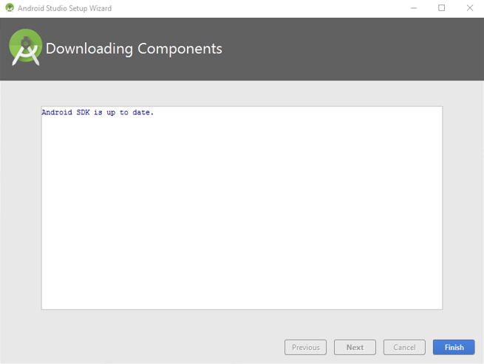
Android Studio
Execute Android Studio Installer
Following the default setting, and then you can finish the installation.
Launch the Android Studio
First time to use will pop setup wizard, and following default setting to complete it.

Slide 20
Android Studio - ubuntu
Android Studio Installation (Ubuntu)
Download Android Studio follow instructions on Windows platform.
Unzip the installation file.
Move the folder to /opt/ by using command, for example the unzipped file is located in my download folder,
then “sudo mv ~/Download/android-studio/ /opt/”
Go to the folder /opt/, and execute the installer by “./studio.sh”
Following the default setting, then complete installation.
If your computer is x64 processer, after complete installation, type the following command to install x86 libraries.
“sudo apt-get install libc6:i386 libncurses5:i386 libstdc++6:i386 lib32z1 libbz2-1.0:i386”
Create a Desktop icon, click Tool -> Create Desktop Entry

Slide 21
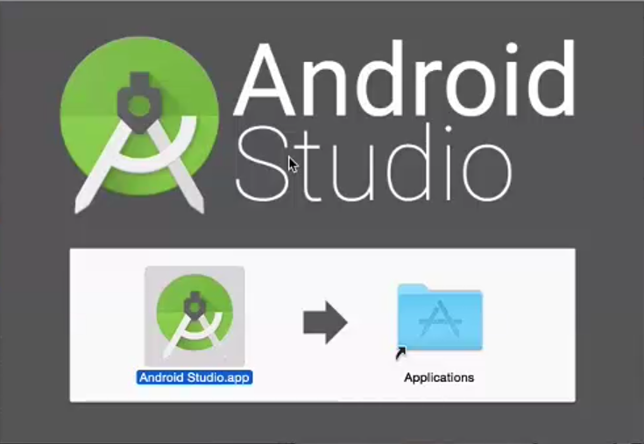
Android Studio - Mac
Android Studio Installation (Mac)
Drag icon into application folder.

Slide 22
Developer workflow
Environment Setup.
Install Android SDK.
Create Android Virtual Device or connect an Android device.
Project Setup and Development.
Build
Generate .apk file using Gradle.
Debug
Device log messages(logcat)
Test
In emulator or your Android device.

Slide 23
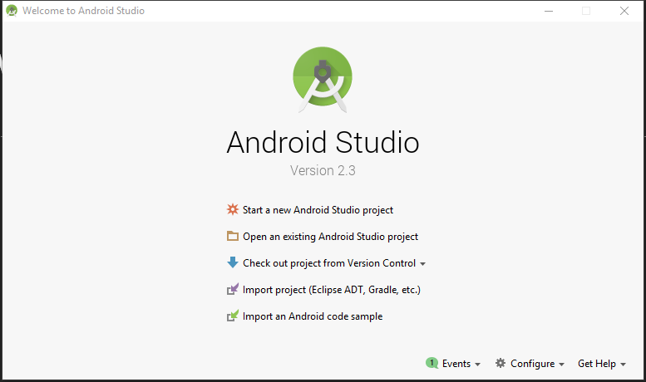

Project1 : HelloWorld
Run Android Studio • Create a new Android Studio Project

Slide 24
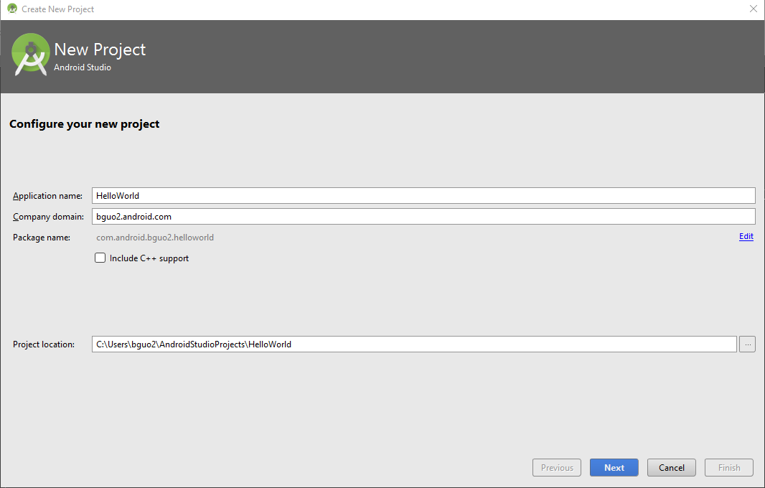
Project1 : HelloWorld
Give a Application Name and Company Name to
your first project

Slide 25
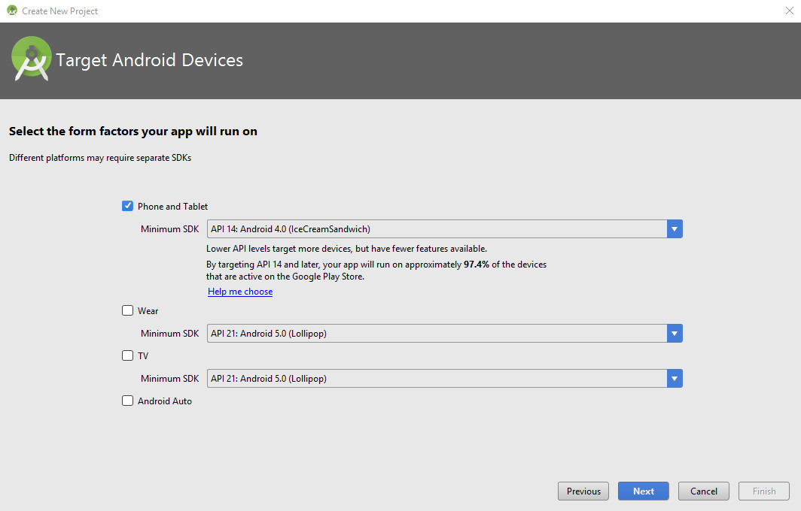
Project1 : HelloWorld
Decide your develop platform and a minimum SDK version

Slide 26
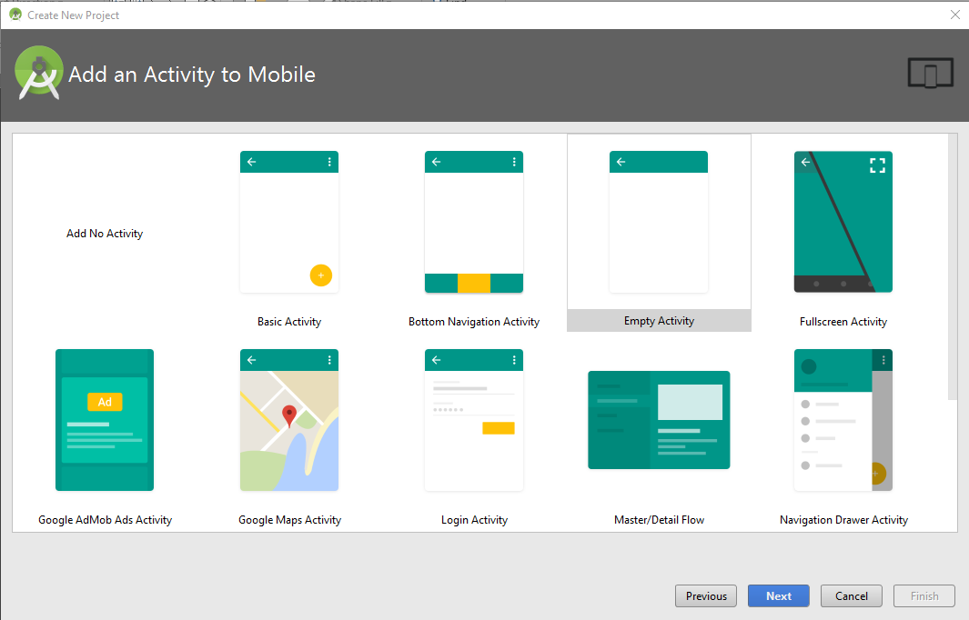
Project1 : HelloWorld
Add an Empty Activity to Mobile

Slide 27
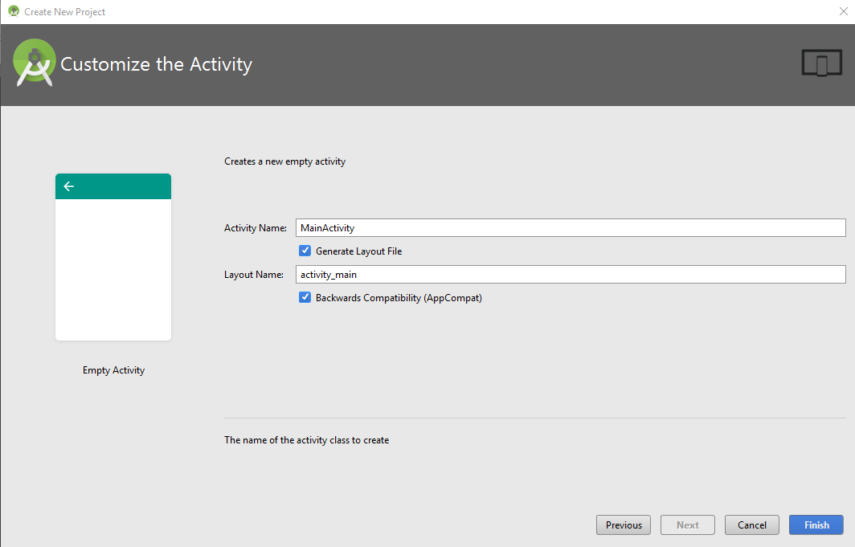
Project1 : HelloWorld
Finish with default setting

Slide 28
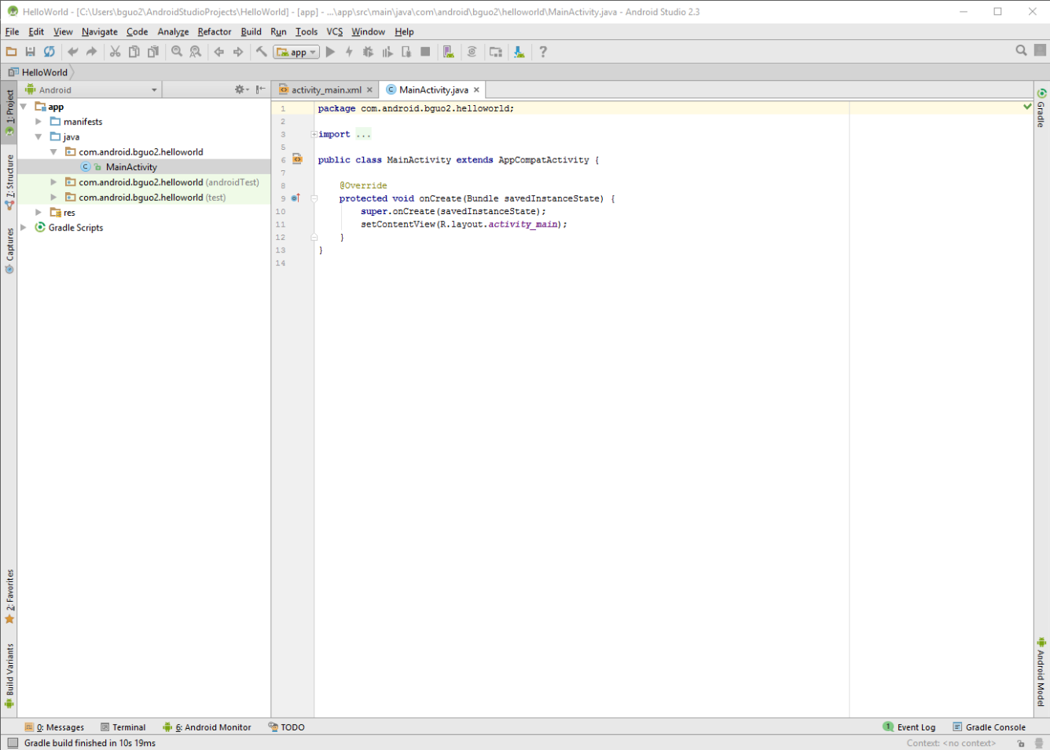
Project1 : HelloWorld
If you cannot see the file explorer, please
click the project button

Slide 29
Project1 : HelloWorld
Error : Gradle Project Sync Fails
Follow the tutorial in the below link:
https://developer.android.com/studio/index.html#migrating-to-android-gradle-plugin-300

Slide 30
Project1 : HelloWorld
Configure your virtual device if there is no physical device connected to computer
Click the Android Virtual Device Manager button in the tool bar
Create a Virtual Device
Select a device you prefer (You’d better to choose smaller screen for acquire high emulate speed if you have no physical device need to test)
Choose corresponding system image (If you use Ubuntu, you should choose arm processer to implement emulate, click “other image” -> “Nougat with arm64 for x64 system” / “Nougat with armeabi for x86 system”)
Keep default setting, and then click icon

Slide 31
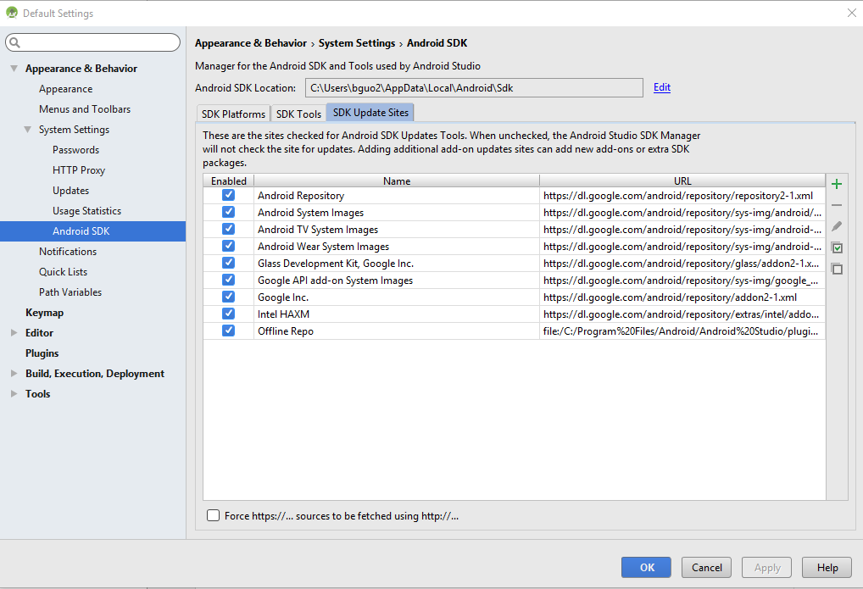
Project1 : HelloWorld
If you haven’t installed haxm, please following instructions below
Click Default Setting button in the tool bar
Go to “SDK Update Sites” tab, install “Intel HAXM” tool.

Slide 32
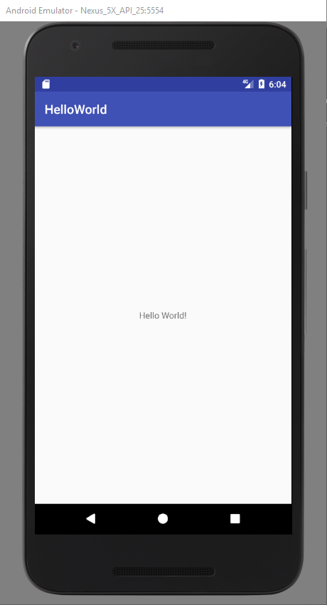
Project1 : HelloWorld
If there is no any problem, you should see the emulator after you click the “Run” button.
The right figure is shown the emulator with NEXUS 5x API 25, Android 7.1.1 version Operating System.

Slide 33
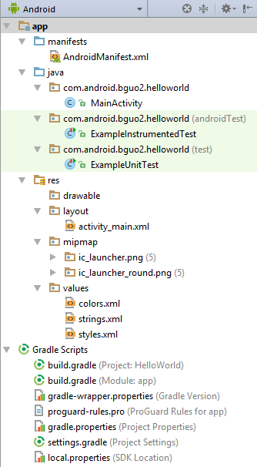
File Structure
java (src)
Java source code, including package, and class.
Important files:
MainActivity.java
Java code for activity class that gets executed when application is running.
xxxUnitTest
Do the unit test for class. You can test your code without execute entirely project.

Slide 34
File Structure
manifests
Important files:
AndroidManifests.xml
List file for entirely project, configures a lot of important information, like package name, permission, and program components.
res
Layout
Important files:
Activity_main.xml
Default file for xml layout file for the activity. Provides both text view and preview of the screen UI

Slide 35
File Structure
drawable
Different resolution will pick different resources in this folder.
values
Store string, theme, color, style and other resources.
Gradle
It’s a kind of dependency management tool, based on Groovy language, replaces configuration in xml.
Important files:
build.gradle
Configure versions of sdk, build tools, application packages, java, and others.

Slide 36
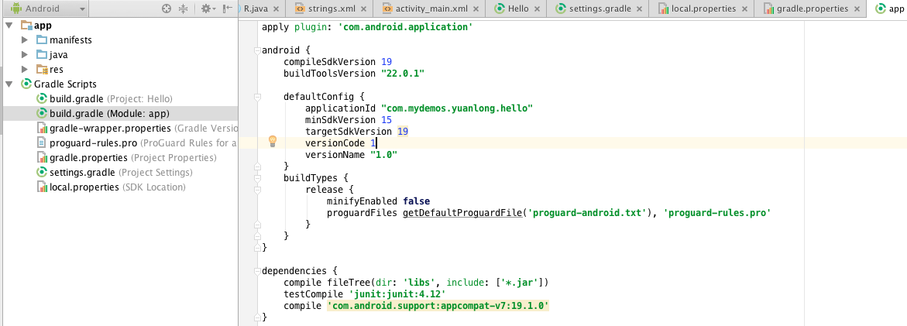
File Structure
Settings for supported Android SDK.

Slide 37
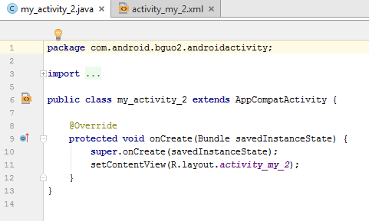
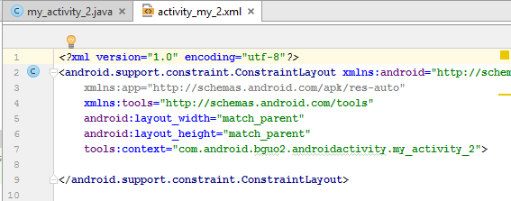
File Structure
Not just UI
Integrate View and Model together.
One activity is a java file, and corresponding view is its xml file.

Slide 38
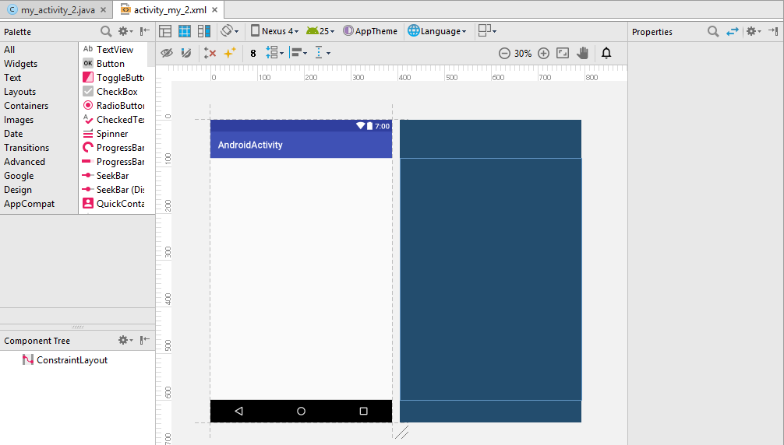
File Structure
UI Design

Slide 39
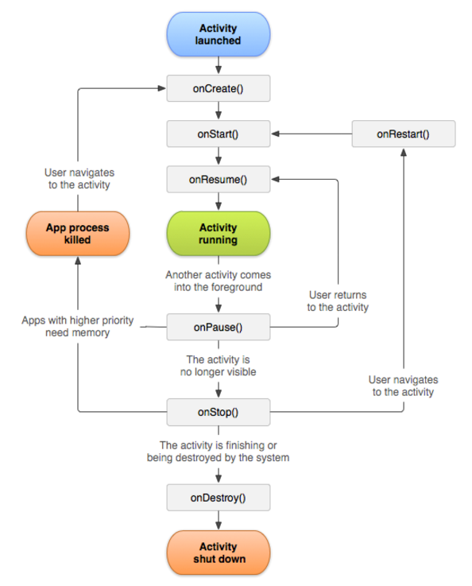
Life Cycle
onCreate()
onStart()
onResume()
onPause()
onStop()
onDestroy()
onRestart()

Slide 40
Testing an Android App
Run on Emulator – Android Virtual Device
AVD Manager is used to configure a virtual device that models a specific device
Run on real Android device
Developer mode should enabled on the mobile device
Run on an Android VM

Slide 41
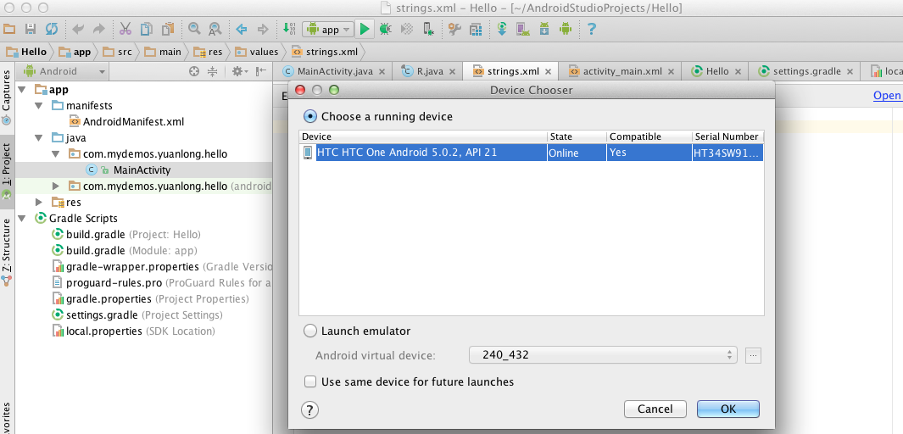
Testing an Android App
(1) Click here.
(2) Select an option in this pop-up window.

Slide 42
Testing an Android App
- Option1
Option 1: Test your App in an Android device.
Step 1: In your Android device,
Enable USB debugging mode. (Note: the steps may depend on what device you are using)
E.g. Go to Settings -> About -> Software information -> More . And then tap “Build number” 7 times to become developer.
Connect your Android device to computer via USB.
Allow USB debugging in your Android Device.

Slide 43
Testing an Android App
- Option1
Option 1: Test your App in an Android device.
Step 2: Go back to “Device Chooser” in Android Studio.
Make sure that the state of device now is “online”.
Choose a running device.
Click “Ok”.
Step 3: Find your Hello App in your Android Studio.

Slide 44
Testing an Android App
- Option2
Option 2: Test your App in an Emulator.
Select “Launch emulator” in “Device Chooser”.
Create an Android Virtual Device(AVD) in virtual device manager.
Select an AVD and install your App in the emulator.

Slide 45
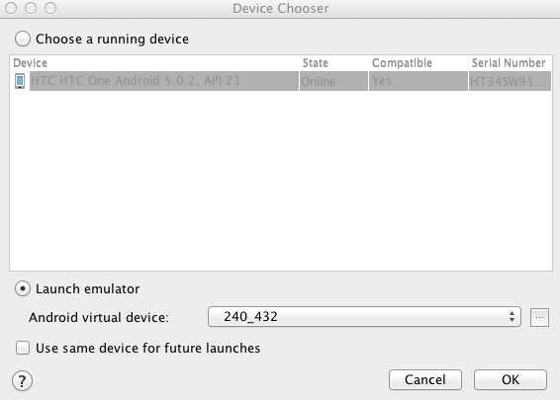
Testing an Android App
- Option2
Click here to create a new
Android Virtual Device.

Slide 46
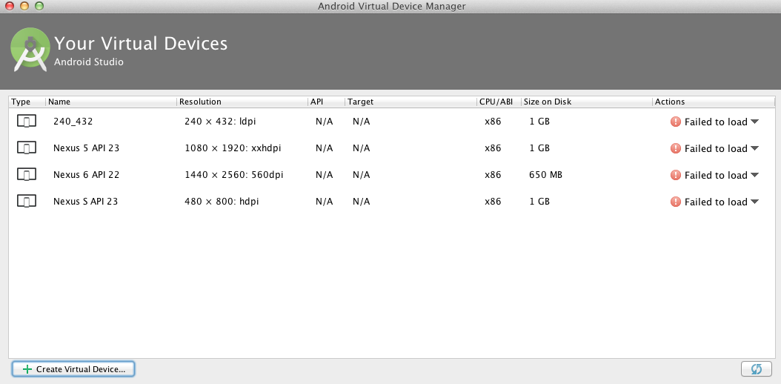
Testing an Android App
- Option2
Click here to create a new
Android Virtual Device.

Slide 47
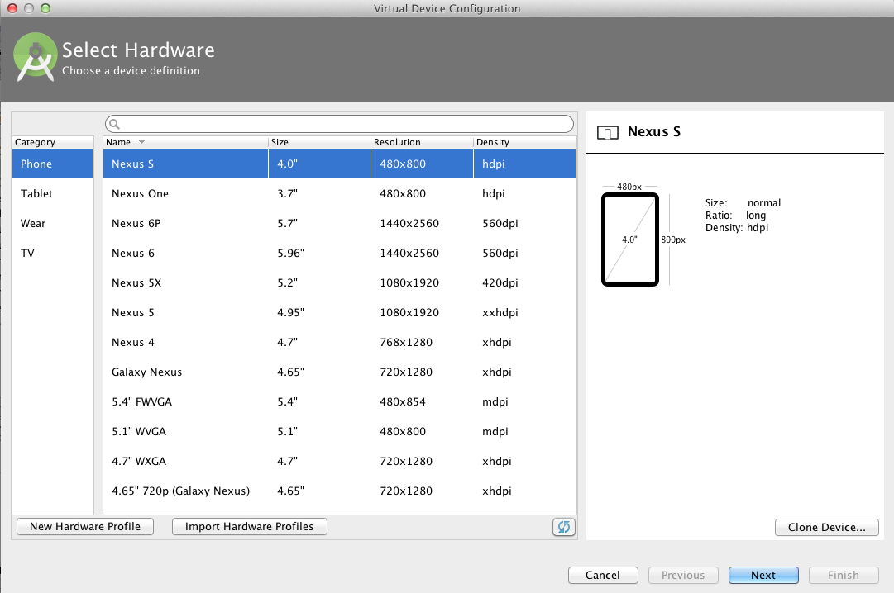
Testing an Android App
- Option2

Slide 48
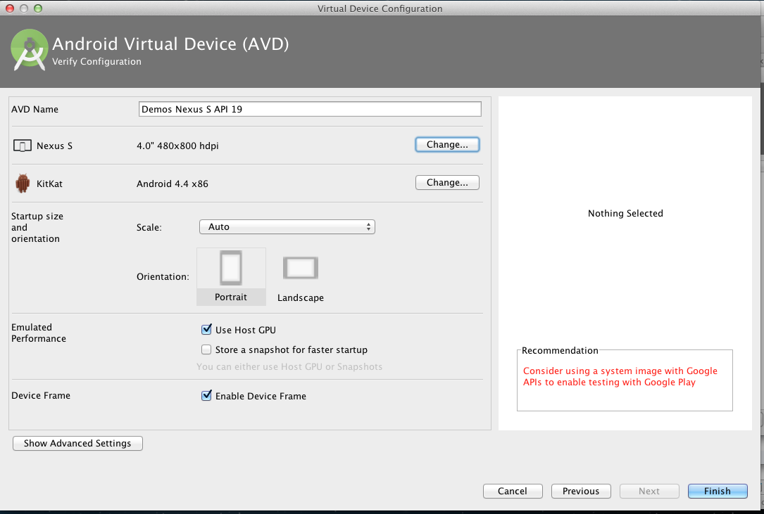
Testing an Android App
- Option2

Slide 49
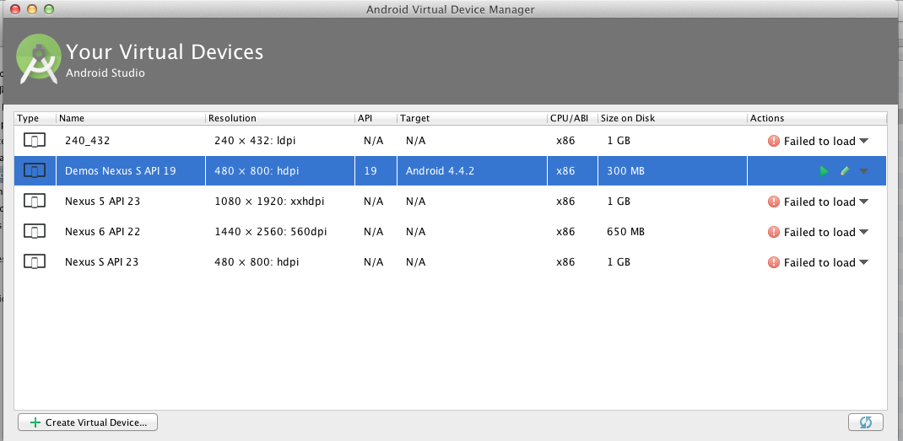
Testing an Android App
- Option2
Once the configuration is finished, a new Android Virtual Device named “Demos Nexus S API 19 ” will be created in the list. After that, please close this window.
Note: if it failed to load, please restart your Android Studio.

Slide 50
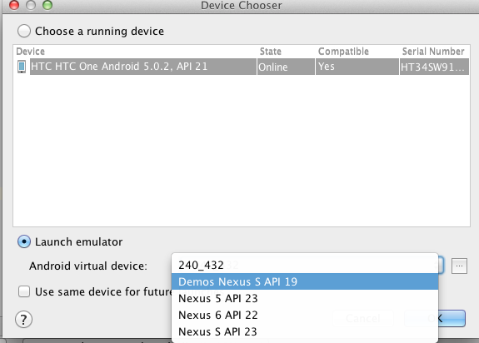
Testing an Android App
- Option2
Select the android virtual device we just created.
Then click Ok.

Slide 51
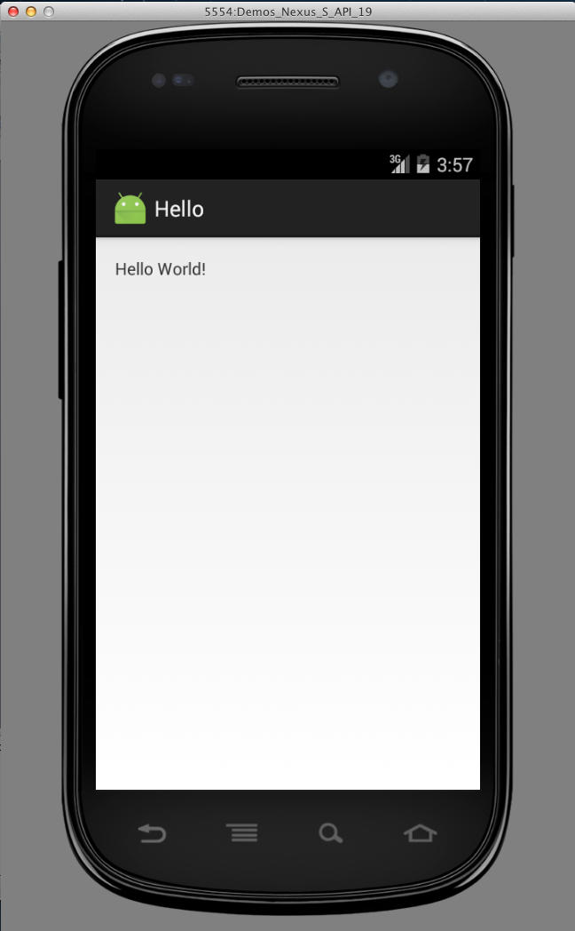
Testing an Android App
- Option2
An emulator will be generated. Android App “Hello” will run on this emulator and print out string “Hello World!”

Slide 52
Extra Feature
Display current process ID.
Open activity_main.java
Add an id for the component TextView.
<TextView android:id="@+id/textViewHello" android:text="Hello World!" android:layout_width="wrap_content" android:layout_height="wrap_content" />
Open MainActivity.java
Add statement “ import android.widget.TextView; “
Type the following statements at the end of onCreate().
int id= android.os.Process.myPid();
TextView text = (TextView) findViewById(R.id.textViewHello);
text.setText("Current Procee ID :"+Integer.toString(id));
Notę: R is a class automatically generated for resources.

Slide 53
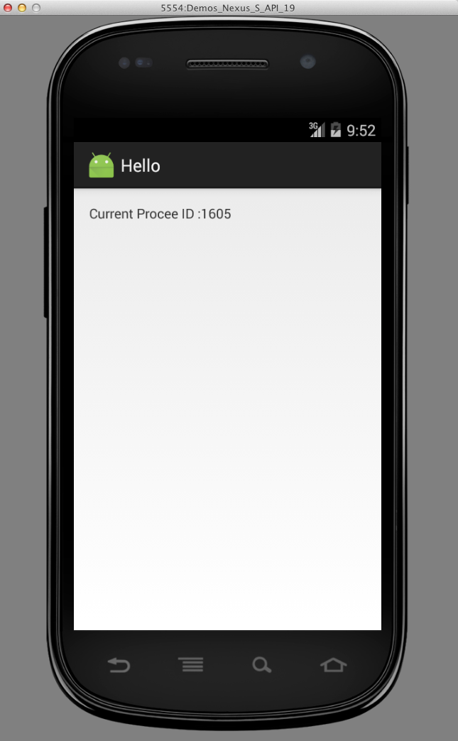
Extra Feature

Slide 54
Project2 : Process Manager
A simple Process Manager
List the processes in Android System.
Displaying the traffic statistics.
See more at http://www.itcuties.com/android/how-to-get-running-process-list-and-traffic-statistics/#sthash.HAPRV4By.dpuf

Slide 55
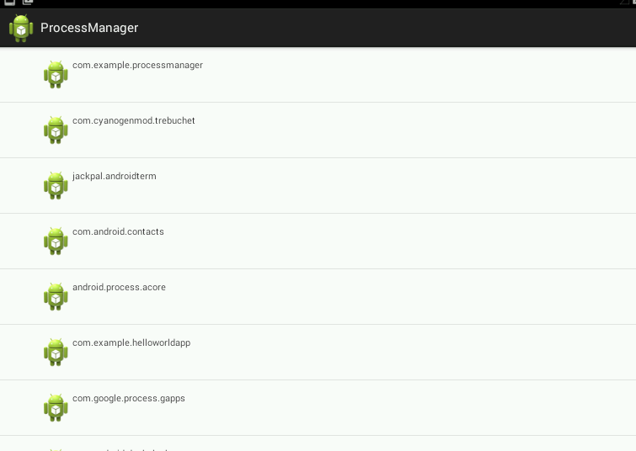
Project2 : Process Manager

Slide 56
Process Manager Step 1
Layout design (res/layout/
activity_main.xml)
Linear layout
Image
Text
<LinearLayout xmlns:android="http://schemas.android.com/apk/res/android"
android:id="@+id/linearLayout1"
android:layout_width="fill_parent"
android:layout_height="fill_parent"
android:layout_alignParentTop="true"
android:orientation="horizontal" >
<ImageView
android:id="@+id/detailsIco"
android:layout_width="wrap_content"
android:layout_height="wrap_content"
android:src="@drawable/ic_launcher" />
<TextView
android:id="@+id/appNameText"
android:layout_width="fill_parent"
android:layout_height="wrap_content"
android:text="APP NAME GOES HERE" />
</LinearLayout>
Note: You need to copy ic_launcher.png from folder “mipmap” to folder “drawable”.

Slide 57
Process Manager Step 2
Building a list for processes
Create a file ListAdapter.java under folder “java”.
Import following packages.
import java.util.List;
import android.app.ActivityManager.RunningAppProcessInfo;
import android.content.Context;
import android.view.LayoutInflater;
import android.view.View;
import android.view.ViewGroup;
import android.widget.ArrayAdapter;
import android.widget.TextView;

Slide 58
Process Manager Step 3
Building a list for processes(continues)
Let ListAdapter extends ArrayAdapter<RunningAppProcessInfo>
Create a constructor for ListApdapter.
public class ListAdapter extends ArrayAdapter<RunningAppProcessInfo> {
// List context
private final Context context;
// List values
private final List<RunningAppProcessInfo> values;
public ListAdapter(Context context, List<RunningAppProcessInfo> values) {
super(context, R.layout.activity_main, values);
this.context = context;
this.values = values;
}
}

Slide 59
Process Manager Step 4
Building a list for processes(continues)
Override method getView()
@Override
public View getView(int position, View convertView, ViewGroup parent) {
LayoutInflater inflater = (LayoutInflater) context.getSystemService(Context.LAYOUT_INFLATER_SERVICE);
View rowView = inflater.inflate(R.layout.activity_main, parent, false);
TextView appName = (TextView) rowView.findViewById(R.id.appNameText);
appName.setText(values.get(position).processName);
return rowView;
}

Slide 60
Process Manager step 5
Display process list and show traffic statistics
Modify MainActivity.java
Extends class ListActivity
Modify OnCreate() so that once app is open all the processes are listed.
Override OnListItemClick() so that once an item in the list is clicked the traffic statistics will be displayed.

Slide 61
Process Manager Step 5
Display process list and show traffic statistics
Import Packages
import java.util.List;
import android.app.ActivityManager;
import android.app.ActivityManager.RunningAppProcessInfo;
import android.app.ListActivity;
import android.net.TrafficStats;
import android.os.Bundle;
import android.view.View;
import android.widget.ListView;
import android.widget.Toast;

Slide 62
Process Manager Step 6
Display process list and show traffic statistics
Definition of MainActivity.java
public class MainActivity extends ListActivity {
}

Slide 63
Process Manager Step 7
Display process list and show traffic statistics
Override OnCreate()
@Override
public void onCreate(Bundle savedInstanceState) {
super.onCreate(savedInstanceState);
// Get running processes
ActivityManager manager = (ActivityManager) getSystemService(ACTIVITY_SERVICE);
List<RunningAppProcessInfo> runningProcesses = manager.getRunningAppProcesses();
if (runningProcesses != null && runningProcesses.size() > 0) {
// Set data to the list adapter
setListAdapter(new ListAdapter(this, runningProcesses));
} else {
// In case there are no processes running (not a chance :))
Toast.makeText(getApplicationContext(), "No application is running", Toast.LENGTH_LONG).show();
}
}

Slide 64
Process Manager Step 8
Display process list and show traffic statistics
Override OnListItemClick()
@Override
protected void onListItemClick(ListView l, View v, int position, long id) {
long send = 0;
long recived = 0;
// Get UID of the selected process
int uid = ((RunningAppProcessInfo)getListAdapter().getItem(position)).uid;
// Get traffic data
recived = TrafficStats.getUidRxBytes(uid);
send = TrafficStats.getUidTxBytes(uid);
// Display data
Toast.makeText(getApplicationContext(), "UID " + uid + " details...\n send: " + send/1000 + "kB" + " \n recived: " + recived/1000 + "kB", Toast.LENGTH_LONG).show();
}

Slide 65
Process Manager Step 9
Test your App in your Android Device or Emulator.

Slide 66
Useful Links
1. Android tutorial for beginners.
https://www.raywenderlich.com/78574/android-tutorial-for-beginners-part-1
2.Android APIs.
http://developer.android.com/reference/packages.html3.
3. How to enable USB debugging mode on Android.
https://www.kingoapp.com/root-tutorials/how-to-enable-usb-debugging-mode-on-android.htm
4. How to get started with Android Programming.
http://x-team.com/2016/01/how-get-started-android-programming/
5.“Android Tablet Application Development For Dummies” By Gerhard Franken

